Slide 1



ZIMBABWE REVENUE AUTHORITY (ZIMRA) CLIENT SATISFACTION SURVEY REPORT
PREPARED BY
PRECISE MANAGEMENT AND RESEARCH CONSULTANCY
FIRST QUARTER (Q1) 2026

Slide 2
RESEARCH BACKGROUND
The Zimbabwe Revenue Authority (ZIMRA) plays a pivotal role in Zimbabwe’s economic framework through the administration of tax and customs regulations, ensuring effective revenue mobilisation and facilitating legitimate trade.
In fulfilling its mandate, ZIMRA serves a diverse client base comprising individuals, businesses, and institutions, with a focus on revenue collection, trade facilitation, taxpayer education, and compliance enforcement.
To evaluate service delivery and strengthen stakeholder engagement, ZIMRA engaged Precise Management and Research Consultancy (PMRC) to conduct a Client Satisfaction Survey for Q1 2026. The survey was designed to measure client satisfaction levels, identify key service strengths and gaps, and generate actionable insights to support continuous improvement.
The study assessed critical dimensions of the client experience, including service efficiency, staff professionalism, communication effectiveness, accessibility of services, and the overall service environment.
The findings from this survey provide an evidence-based foundation to support ZIMRA in refining its operational strategies, enhancing service responsiveness, and improving overall client engagement.
By leveraging these insights, ZIMRA seeks to reinforce its commitment to delivering high-quality, client-centric services while systematically addressing identified areas for improvement.

Slide 3
CLIENT SATISFACTION SURVEY OVERVIEW – Q1 2026
The overall Client Satisfaction Index (CSI) for Q1 2026 is recorded at 74%, reflecting a generally positive client experience across ZIMRA services. Satisfaction is supported by strong performance across key service attributes, particularly Access and Inclusion (79%), Public Trust (78%), and Brand Strength/Reputation (78%), indicating growing confidence in the Authority’s service delivery and institutional standing.
Operational efficiency indicators also remain favourable, with Customer Effort Score (77%) and Service Efficiency and Competence (77%) suggesting that clients are able to access services with relative ease and interact with capable personnel. However, comparatively lower scores in Reputational Risk (73%) and Integrity and Governance Climate (73%) highlight areas requiring continued attention to strengthen overall perception and trust.
In terms of client advocacy, the overall Net Promoter Score (NPS) stands at +11, indicating moderate levels of client loyalty. Regional performance shows variability, with Region 3 (+17) and Forbes (+15) demonstrating stronger advocacy, while Region 1 (+4) and Beitbridge (+9) indicate comparatively lower levels of client endorsement.
A total of 1,544 responses were collected nationwide during the survey period through a combination of online and physical data collection methods across all administrative regions.
Following data cleaning and validation including the removal of duplicate submissions, incomplete questionnaires, and responses with insufficient coverage of key service attributes the final dataset was used for Customer Satisfaction Index (CSI) computation and net-score analysis.

Slide 4
CLIENT SATISFACTION SURVEY OBJECTIVES
The Client Satisfaction Survey seeks to assess the experiences and perceptions of clients who interact with the Zimbabwe Revenue Authority (ZIMRA) across its service points. The key objectives are:
To identify gaps and improve the Authority’s service delivery
To receive feedback on perception and of obtain recommendations on desired service improvements directly from the clients
To help operations address gaps identified in the report
To help operations address gaps identified in the report

Slide 5
RESEARCH DESIGN
Where | Database- ZIMRA active clients. Data collection was done across all regions and border posts: Region 1 Region 2 Region 3 Head Office Beitbridge Border Post Forbes Border Post
When | Field work was conducted in the month of March 2026.
Limitation | Limited Client Volumes at Certain Locations: Some border posts and service stations experienced low client traffic during the survey period, which affected the volume of responses collected. Low Participation from Clearing Agents : Reduced business activity among clearing agents at the airport resulted in a lower response rate from this key stakeholder group.

Slide 6
DEMOGRAPHIC PROFILE
Individual taxpayers (15%) – Almost equal to corporates, showing that individuals are also an important part of the mix.
SMEs (15%) – Small and medium enterprises make up a similar share to individuals, highlighting their growing role.
Clearing agents (9%) – A smaller but notable group, important for logistics and customs processes.
Transporters (9%) – Also a modest share, reflecting the role of companies that move goods.
Cross‑border traders (7%) – A niche group, smaller in size but vital for regional trade links.
Government (5%) – The smallest category, showing limited direct involvement compared to private sector customers.
Importers/Exporters (25%) – This is the largest group, showing that one in four customers are involved in international trade.
Corporate taxpayers (16%) – A strong segment, representing established companies that contribute significantly to the customer base.

Slide 7
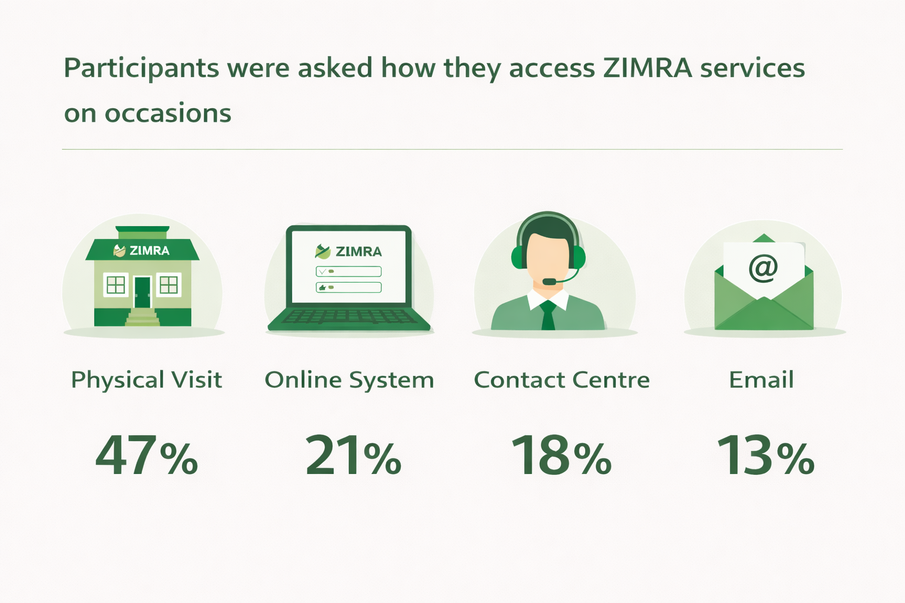
Contact Centre (18%) – A smaller but important group relies on phone or call centre support, showing the need for accessible communication channels.
Email (13%) – The least used method, but still relevant, as some customers prefer written communication for record‑keeping.
Physical visit (47%) – Almost half of customers prefer to come in person, showing that face‑to‑face service is still the most common way people engage.
Online system (21%) – About one in five customers use digital platforms, which highlights growing adoption of online services.

Slide 8
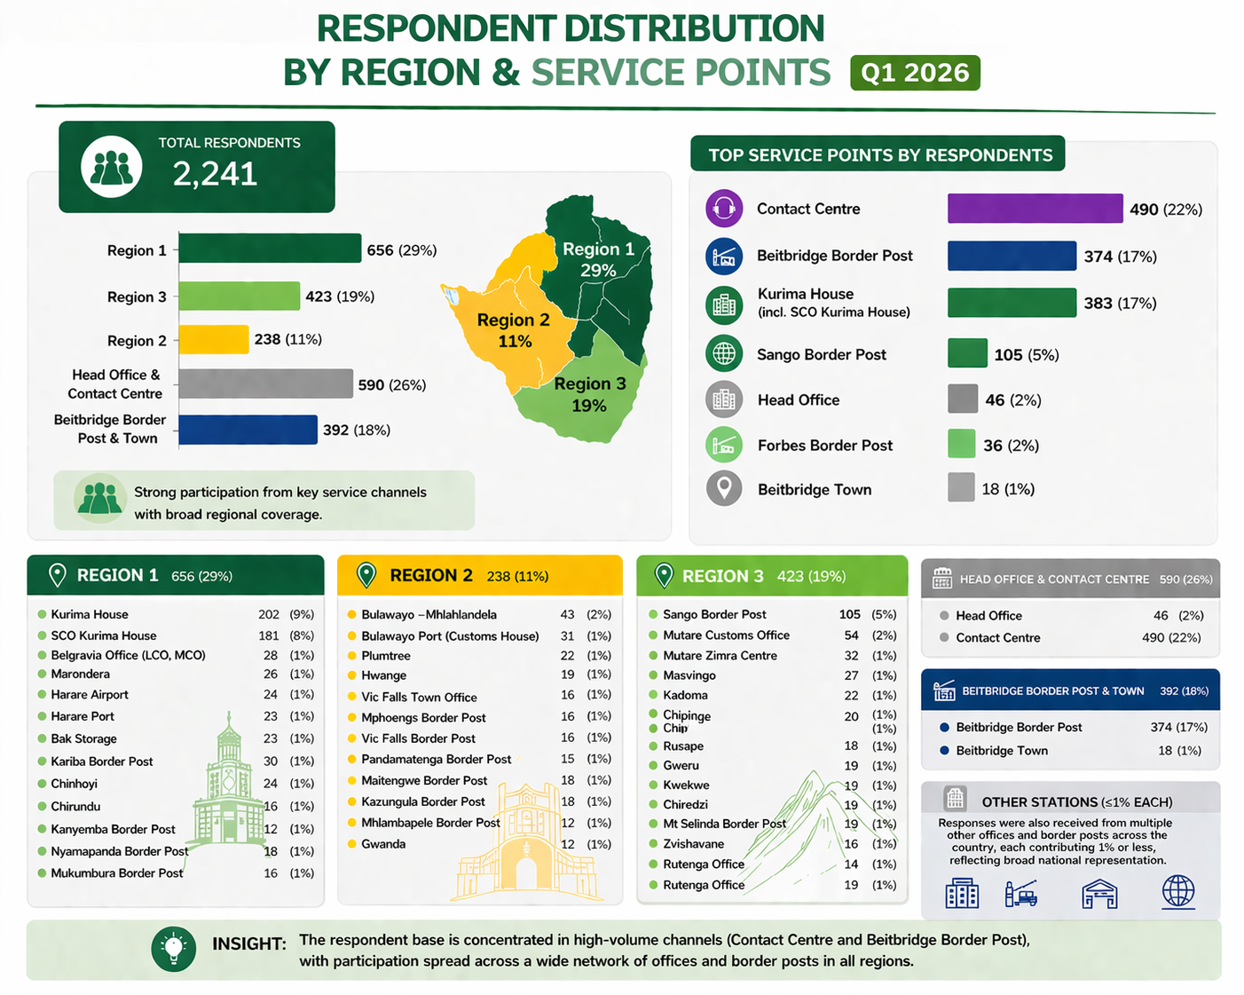

Slide 9
DEFINITION OF THE METRICS/ INDICES MEASURED
The survey sought to measure the following metrics across all the regions and borders:
Metric/ Index Measured | Definition | Current Status/Level
Client Satisfaction Index (CSI) | A metric used to measure customer satisfaction with a company's products, services, or overall experience. It provides insights into how well a business meets customer expectations and helps identify areas for improvement. | 74%
Customer Effort Score (CES) | A metric that measures how much effort a customer has to exert to interact with a company, whether it's resolving an issue, making a purchase, or using a product/service. The lower the effort required, the higher the likelihood of customer satisfaction and loyalty. | 77%
Net Promoter Score (NPS) | is a widely used customer loyalty metric that measures how likely customers are to recommend a company's product or service to others. | 11

Slide 10
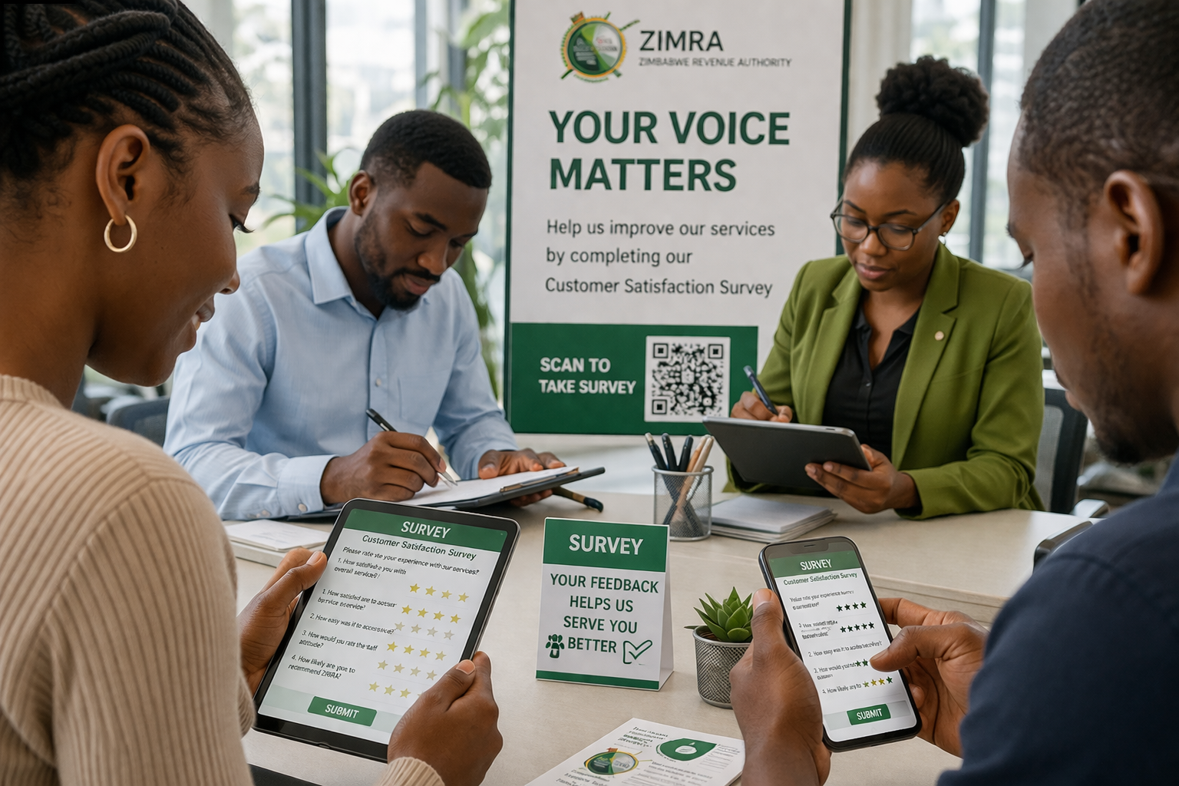
EXECUTIVE SUMMARY

Slide 11

OVERALL CLIENT SATISFACTION INDEX
While the overall CSI remains 74%, variations across regions reflect differences in traffic volumes, system reliance, and service complexity.
The regional results provide deeper insight into how ZIMRA’s operational performance varies across service points, particularly between inland offices and high-volume border posts.

Slide 12
Overall Regional Performance
High Performance Location
Q1 2026 CSI: 74%
The relatively narrow range (72% – 77%) indicates:
  Consistent service delivery standards across ZIMRA
  No severely underperforming region
  However, no region has exceeded 80%, suggesting system-wide improvement opportunities
Forbes Border Post – 77%
This is the best-performing station, indicating relatively stronger service delivery.
Operational Interpretation:
More manageable traffic volumes compared to major borders like Beitbridge
There is efficient processing of systems and shorter queues
Better client-staff interaction due to lower congestion

Slide 13
Moderate Performing Regions
Low Performing Locations
Region 2 – 75%
Region 3 – 74%
Region 1 – 73%
These regions represent ZIMRA’s core inland operations, including domestic tax offices and some customs activities.
Operational Interpretation:
Fairly stable performance in:
  Tax processing
  Client support services
Noted challenges include:
  System inefficiencies (e-filing, payment platforms)
  Turnaround times for assessments and queries
  Client communication gaps
Head Office – 72%
Beitbridge Border Post – 72%
These scores highlight pressure points within ZIMRA’s operations.
Head Office (72%)
Despite being the strategic and administrative hub, Head Office records one of the lowest scores.
Operational Interpretation:
Noted challenges especially in:
  Escalation handling and query resolution delays
  Policy interpretation inconsistencies
  Centralized systems responsiveness

Slide 14
Beitbridge Border Post (72%)
As Zimbabwe’s busiest border post, this score is significant.
Operational Interpretation:
High traffic volumes (commercial and passenger)
Common operational challenges:
  Long queues and delays
  System downtime affecting clearance
  Congestion in cargo processing
  Multiple agency coordination issues

Slide 15
OVERALL INDICES BY SERVICE ATTRIBUTES
SERVICE ATTRIBUTES | Region 1 | Region 2 | Region 3 | Head Office | Forbes | Beitbridge | Q1,2026 ZIMRA Overall Indices
SERVICE EFFICIENCY AND COMPETENCE | 77% | 70% | 75% | 75% | 89% | 78% | 77%
DIGITAL EXPERIENCE | 76% | 71% | 74% | 75% | 80% | 76% | 75%
ACCESS AND INCLUSION | 78% | 76% | 73% | 77% | 87% | 81% | 79%
BRAND STRENGTH/REPUTATION | 81% | 76% | 79% | 74% | 81% | 74% | 78%
PUBLIC TRUST | 82% | 74% | 74% | 79% | 83% | 77% | 78%
INTEGRITY AND GOVERNANCE CLIMATE | 58% | 76% | 76% | 75% | 80% | 75% | 73%
REPUTATIONAL RISK INDICATOR | 50% | 76% | 79% | 74% | 88% | 73% | 73%
STAKEHOLDER CONFIDENCE | 76% | 77% | 73% | 73% | 80% | 71% | 75%
CUSTOMER EFFORT SCORE | 82% | 71% | 73% | 76% | 85% | 72% | 77%
OVERAL CSI BY REGION | 73% | 74% | 75% | 72% | 77% | 72% | 74%

Slide 16
CSI OVERALL FINDINGS
The Q1 2026 ZIMRA Satisfaction Index of 74% reflects a generally positive but moderate performance, indicating that while clients are largely satisfied with ZIMRA’s services, there are clear opportunities for improvement, particularly in governance, trust reinforcement, and digital experience optimization.

Slide 17
SERVICE DELIVERY AND OPERATIONAL PERFORMANCE
Service delivery indicators remain relatively strong, showing that ZIMRA is performing well in its core mandate of tax and customs administration.
Service Efficiency and Competence (77%)
Customer Effort Score (77%)
These scores suggest that:
Clients find ZIMRA staff reasonably competent and capable
Processes are fairly efficient, with manageable effort required to access services
However, scores below 80% indicate room to reduce delays, bureaucracy, and complexity
DIGITAL EXPERIENCE
Digital Experience (75%)
This reflects moderate satisfaction with ZIMRA’s digital platforms, such as online filing systems and e-services.
These scores suggest that:
Systems are functional but not fully optimized
Users still experience:
  System downtime
  Navigation challenges
  Inconsistent user experience

Slide 18
3. ACCESS AND INCLUSION
Access and Inclusion (79%)
This is one of the strongest-performing dimensions, indicating that:
ZIMRA services are largely accessible across different client segments
There is fair reach across regions and taxpayer categories
4. BRAND STRENGTH AND PUBLIC PERCEPTION
Brand Strength/Reputation (78%)
Public Trust (78%)
Stakeholder Confidence (75%)
These scores indicate:
A generally positive institutional image
Clients perceive ZIMRA as credible and important, but not yet fully trusted
Confidence is slightly lower, suggesting cautious optimism among stakeholders

Slide 19
5. GOVERNANCE, INTEGRITY AND RISK
Integrity and Governance Climate (73%)
Reputational Risk Indicator (73%)
These scores indicate:
Perceived gaps in:
  Transparency
  Accountability
  Ethical conduct
Elevated reputational risk exposure
6. OVERALL PERFORMANCE INTERPRETATION
Overall Satisfaction Index: 74%
This places ZIMRA in a Good but not excellent performance category
Strengths
Strong service delivery foundation
Good accessibility and inclusion
Positive institutional reputation
Areas for Improvement
Digital systems and user experience
Governance and integrity perception
Building deeper public trust and confidence
Conclusion
ZIMRA’s Q1 2026 results reflect a stable and functional organisation with strong operational delivery, but constrained by perception-related challenges, particularly around governance and digital experience. Addressing these gaps will be critical in enhancing client satisfaction, strengthening trust, and reducing reputational risk going forward.

Slide 20
STATION SPECIFIC CLIENT SATISFACTION INDEX SUMMARY
3. ACCESS AND INCLUSION
Region 1 |  | Region 2 |  | Region 3 |  | Head Office |  | Beitbridge |  | Forbes
Station | CSI | Station | CSI | Station | CSI | Station | CSI | Station | CSI | Station | CSI
Harare Airport | 71% | Vic Falls Town Office | 79% | Chipinge | 76% | Head Office | 72% | Beitbridge Border | 72% | Forbes Border Post | 77%
Harare Port | 70% | Gwanda | 73% | Chiredzi | 74% | Contact Centre | 72% | Beitbrideg Town Office | 71%
Chinhoyi | 77% | Hwange | 74% | Gweru | 74%
Bindura | 77% | Bulawayo Mhlahlandela | 76% | Kadoma | 73%
Chirundu | 72% | Bulawayo Port | 78% | Masvingo | 69%
Marondera | 72% | Plumtree | 73% | Mt Selinda Border Post | 74%
Belgravia | 79% | Mphoengs Border Post | 74% | Mutare Customs | 78%
Kurima House | 79% | Pandamatenga Border Post | 71% | Mutare Zimra Centre | 79%
SCO Kurima | 62% | Maitengwe Border Post | 73% | Rusape | 80%
Bak Storage | 83% | Vic Falls Border Post | 76% | Rutenga Office | 82%
Kanyemba Border Post | 73% | Mhlambapele Border Post | 70% | Sango Border Post | 77%
Kariba Border Post | 73% | Kazungula Border Post | 73% | Zvishavane | 63%
Nyamapanda Border Post | 69%
Mukumbura Border Post | 69%

Slide 21

NET PROMOTER SCORE (NPS)
The Net Promoter Score (NPS) measures clients’ likelihood to recommend NAC services to others, serving as an indicator of client loyalty and advocacy. It is calculated as:
Where:
Promoters (score 9–10): Highly satisfied and likely to recommend.
Passives (score 7–8): Satisfied but neutral; not counted in NPS calculation.
Detractors (score 0–6): Unhappy clients who may discourage others.
NPS ranges from -100 to +100.
Below 0 | Needs significant improvement (more detractors than promoters).
Above 0 | Good (more promoters than detractors, a healthy baseline).
Above 20 | Favourable/Great (indicating people are favouring the brand).
Above 50 | Excellent/Amazing (strong customer loyalty).
Above 70 | World-class/Exceptional

Slide 22
OVERALL ZIMRA NET PROMOTER SCORE BY REGION
Operational Meaning for ZIMRA:
Clients will use ZIMRA because they must (compliance-driven), but:
  Not many are enthusiastic advocates
  Experiences are acceptable but not memorable
ZIMRA Client Satisfaction Survey – Q1 2026: Net Promoter Score (NPS) Analysis (Overall NPS: +11)
The overall Net Promoter Score (NPS) of +11 places ZIMRA in the “Good” category, meaning:
ZIMRA has achieved a positive perception baseline
The organisation is not at risk (no negative NPS)
However, it has not yet built strong loyalty or brand advocacy

Slide 23
REGIONIONAL NPS PERFORMANCE BREAKDOWN
High Performing Regions
Region 3 – NPS: +17
Forbes Border Post – NPS: +15
These are the strongest performers, approaching the “Favourable/Great” threshold (20+).
Operational Interpretation:
Better client experience consistency
Fewer service frustrations (delays, system issues)
More positive staff-client interactions
Moderate Performing Regions
Head Office – NPS: +12
Beitbridge Border Post – NPS: +9
Region 2 – NPS: +8
These fall within the “Good” range, but below the overall benchmark for strong loyalty.
Operational Interpretation:
Clients are generally satisfied but not impressed due to presence of:
  Service delays
  System inefficiencies
  Communication gaps
Lower Performing Region
Region 1 – NPS: +4
Although still positive, this is very close to neutral, indicating:
Nearly equal proportions of promoters and detractors
Operational Interpretation:
Higher likelihood of:
  Client frustrations
  Inconsistent service delivery
  Poorer communication or longer turnaround times

Slide 24
KEY DRIVERS OF NPS AT ZIMRA & OVERALL ZIMRA PAIN POINTS
Overall ZIMRA Client Pain Points
1. System & Digital Platform Issues
System is slow or unreliable, often only functional at night
Frequent system downtime affecting service delivery
Online platforms not user-friendly
Poor system maintenance
Payment processing delays across banks
2. Service Efficiency & Delays
Long waiting times and delayed processing of services (rebates, clearances, refunds)
Delays at border posts and town offices, especially during holidays and peak periods
Slow physical inspections and document processing at border post eg Beitbridge, Kazungula and Plumtree
Rebate processing can take up to one month
Bureaucratic procedures causing unnecessary delays
Across all regions, NPS is influenced by:
Positive Drivers (Promoters)
Efficient service and shorter queues
Professional and helpful staff
Smooth digital transactions
Negative Drivers (Detractors)
System downtime and online platform issues
Long waiting times (especially at borders)
Poor communication and feedback delays
Perceived inefficiencies in handling queries

Slide 25
ZIMRA PAIN POINTS
5. Customer Service & Professionalism
Staff are rude, harsh, or unprofessional e,g Bindura as well as border post staff unprofessional during peak periods
Harassment at checkpoints despite compliance noted at Harare Airport, Beitbridge Border, Forbes Border Post, ZIMRA enforcement team
Physical inspections and confiscations perceived as excessive eg Harare Airports, Bak Storage, GMS Mutare, CEVA Mutare
6. Corruption, Fairness & Accountability
Allegations of bribery for faster service most common at all border post
Perceived bias in service delivery
Accountability issues for staff conduct noted at Kurima House, Gweru, Bulawayo Mhlahlandela
3. Staffing & Capacity Issues
Insufficient personnel at border posts and town offices
Staff shortages leading to slow service delivery
Staff not available or responsive on phone/email e.g contact centre, Bulawayo Port, Rusape, Hwange, Gwanda, SCO Kurima, GMS Mutare, Kwekwe
4. Communication & Responsiveness
Contact lines often unanswered; emails and calls delayed (toll-free numbers not working)
Communication between ZIMRA and clients inconsistent there are multiple referrals without resolution especially at Kurima House, Gweru, Belgravia LCO
Poor guidance on processes and procedures

Slide 26
ZIMRA PAIN POINTS & OVERALL IMPROVEMENTS
Tax Compliance Burden & SME Concerns
Complex tax processes for SMEs and individual taxpayers
Excessive penalties and interest charges
Tax obligations seen as punitive or inflexible
New taxpayers lack awareness and education
8. Documentation & Process Complexity
Excessive documentation requirements
Forms disorganised, unavailable, or in short supply noted at Mphoengs Border Post, Kanyemba Border Post, Beitbridge Border Post, Maitengwe Border, Kazungula Border, Sango Border Post
Procedures for reporting issues unclear
Overall Suggested Improvements for ZIMRA
1. System & Digital Platform
Upgrade and stabilise all digital platforms (TaRMS, online portals)
Ensure systems work 24/7 and perform consistently during peak hours
Improve ICT infrastructure and internet connectivity
Regular system maintenance and updates but please raise awareness first to the ZIMRA clients if there are any system maintenance issues
2. Service Efficiency & Process Improvements
Streamline workflows and reduce waiting times
Process rebates, refunds, and clearances faster
Introduce digital pre-clearance to reduce physical visits

Slide 27
6. Tax Compliance Support
Provide targeted SME training and support
Educate new taxpayers about processes and obligations
Simplify compliance procedures where possible
Review penalties and interest to be fair and reasonable
8. Documentation & Process Simplification
Reduce the number of required documents
Digitise forms and make them easily accessible
Organise forms systematically and ensure availability
Clarify issue reporting procedures
9. Infrastructure & Access
Ensure communication lines are functional at all times
Expand capacity for online and offline service access
10. Enforcement & Border Post Practices
Train border and enforcement staff for fair and respectful conduct
Reduce unnecessary inspections or confiscations
Improve efficiency during peak travel or holiday periods
3. Staffing & Capacity
Increase staffing at border posts and town offices
Deploy extra personnel during holidays and peak periods
Ensure adequate staffing in contact centres
4. Communication & Responsiveness
Improve responsiveness on phone lines, WhatsApp, and email
Standardise information shared with clients
Notify clients proactively about changes in policies or systems
Assign dedicated liaison officers for complex client queries
Conduct regular feedback surveys and workshops
5. Customer Service & Professionalism
Train staff on professionalism, ethics, and client engagement
Encourage respectful and supportive treatment of all taxpayers
Monitor staff conduct and enforce accountability
Do training to ZIMRA staff of Customer Handling or Customer Service Experience as well as Emotional Intelligence
Rotate staff to reduce opportunities for bias

Slide 28
REGIONAL ANALYSIS
BEITBRIDGE

Slide 29
BEITBRIDGE BORDER POST SERVICE CHALLENGES ANALYSIS (BEITBRIDGE BORDER VS TOWN POST)
Service challenges in the Beitbridge Region are driven by a combination of operational delays at the Border Post and system-related inefficiencies at the Town Office, with information clarity and documentation requirements consistently contributing to increased customer effort across both stations.

Slide 30
Major Challenge: Delays (Border: 30% | Town: 25%)
Delays emerge as the most significant issue across both stations, particularly at the Border Post.
At the Border Post, this is driven by:
  High transaction volumes
  Clearance bottlenecks
  Physical verification processes
At the Town Office, delays are present but less severe, likely linked to:
  Internal processing inefficiencies
  slower response times
Delays are the primary pressure point, especially at the Border, directly affecting customer effort and overall satisfaction.
System Issues (Border: 22% | Town: 27%)
System challenges are more pronounced at the Town Office.
Town Office:
  Greater reliance on digital platforms
  System downtime or slow systems impacting service delivery
Border Post:
  Systems are critical, but operational processes partly compensate
While the Border struggles with physical congestion, the Town Office is more affected by digital system reliability.

Slide 31
Unclear Information (Border: 17% | Town: 16%)
Fairly consistent across both stations.
Clients experience:
  Lack of clarity on procedures
  Uncertainty on requirements
There is a system-wide gap in information clarity, contributing to repeated inquiries and increased customer effort.
Communication (Border: 13% | Town: 16%)
Slightly higher concern at the Town Office
Town Office:
  Gaps in feedback and updates
  Limited proactive engagement
Border Post:
  Communication affected more by workload than structure
Communication is not critically weak but remains an area for service enhancement, especially in managing expectations.
Documentation Requirements (Border: 13% | Town: 14%)
Almost identical across both stations.
Clients perceive:
  Processes as cumbersome
  Requirements as excessive or unclear
Documentation is viewed as procedurally heavy, reinforcing the high Customer Effort Scores observed earlier.

Slide 32
Attributes | Beitbridge Border Post | Beitbridge Town | Beitbridge
Service Efficiency And Competence | 77% | 78% | 78%
Digital Experience | 74% | 78% | 76%
Access And Inclusion | 77% | 85% | 81%
Brand Strength/Reputation | 68% | 80% | 74%
Public Trust | 75% | 79% | 77%
Integrity And Governance Climate | 73% | 77% | 75%
Reputational Risk Indicator | 68% | 78% | 73%
Stakeholder Confidence | 68% | 74% | 71%
Customer Effort Score | 69% | 74% | 72%
NPS | 9 | 8 | 9
Overal CSI Region 2 | 72% | 71% | 72%
The Beitbridge Region reflects a dual-service environment:
Border Post → High-volume, transactional, time-sensitive (imports/exports, clearing agents)
Town Office → Lower volume, more administrative and advisory (taxpayer services)
Across both stations, the region shows:
Moderate satisfaction driven by staff effort and system presence
Persistent strain from process inefficiencies and system limitations
Clear divide between operational pressure (border) and service experience (town)

Slide 33
BEITBRIDGE BORDER POST PAIN POINTS & RECOMMENDATIONS
Operational Context
High traffic (cross-border trade, haulage, clearing agents)
Time-sensitive environment → delays have financial implications
Heavy reliance on systems (ASYCUDA, online platforms)
Key Pain Points (Border Post)
1. Delays in Clearance Processes
Slow processing times, especially during peak periods
Congestion and long queues for physical verification
2. System Downtime & Instability
Frequent interruptions affecting clearance timelines
Overdependence on digital systems without backup efficiency
3. Inconsistent Communication
Clients unclear on procedures, requirements, and status updates
Limited real-time feedback during processing
4. Customer Handling Under Pressure
Staff responsiveness affected by workload
Perceived professionalism gaps during peak congestion

Slide 34
BEITBRIDGE BORDER POST RECOMMENDATIONS
Recommendations (Border Post)
1. System Reliability Enhancements
Strengthen system uptime (redundancy/backups)
Introduce offline contingency workflows during downtime
2. Real-Time Communication Systems
Digital tracking (SMS/online updates for clearance stages)
Clear service timelines displayed publicly
3. Transparency Protocols
Publish step-by-step clearance procedures
Standardise requirements across officers
4. Frontline Staff Capacity Support
Deploy additional staff during peak periods
Customer service reinforcement training (high-pressure environments)
5. Operational Context
Lower traffic compared to border
Focus on:
  Tax services
  General inquiries
  Compliance support
6. Process Optimisation & Fast-Track Lanes
Introduce segmented clearance channels:
  Pre-cleared cargo
  Low-risk clients
Reduce congestion and turnaround time

Slide 35
BEITBRIDGE TOWN OFFICE - KEY PAIN POINTS
Key Pain Points (Town Office)
1. Limited Digital Adoption
Continued reliance on physical visits
Low uptake of online/self-service platforms
2. Service Efficiency Gaps
Slow response times for queries
Delays in resolving taxpayer issues
3. Professionalism & Customer Experience
Some feedback indicating:
  Lack of professionalism
  Inconsistent service standards
4. Low Awareness of Services
Clients unaware of available digital channels
Limited communication on processes

Slide 36
BEITBRIDGE TOWN OFFICE - RECOMMENDATIONS
Recommendations (Town Office)
1. Digital Channel Promotion
Drive adoption of:
  Online tax platforms
  Email/contact centre usage
Awareness campaigns (on-site + digital)
2. Service Efficiency Improvement
Introduce service turnaround benchmarks
Monitor and publish performance metrics
3. Customer Service Standardisation
Staff training on:
  Professional conduct
  Client engagement
Introduce service charters visibly displayed
4. Client Education Initiatives
On-site guidance desks
Simple process guides for taxpayers
5. Feedback & Resolution Mechanism
Strengthen complaint handling system
Ensure visible escalation channels

Slide 37
HEAD OFFICE ANALYSIS

Slide 38
SERVICE CHALLENGES ANALYSIS (HEAD OFFICE + CONTACT CENTRE)
Service challenges at Head Office are primarily driven by system-related inefficiencies, while the Contact Centre is more affected by delays and information clarity gaps, with documentation requirements remaining a consistent source of customer effort across both channels

Slide 39
Major Challenge: Delays (Head Office: 25% | Contact Centre: 29%)
Delays are a key concern across both channels, more pronounced at the Contact Centre.
Contact Centre:
  High call volumes
  Waiting times and slow query resolution
Head Office:
  Internal processing delays
  Longer turnaround times for complex issues
Delays reflect capacity and response-time pressures, particularly in client-facing support channels.
System Issues (Head Office: 33% | Contact Centre: 24%)
This is the most significant challenge at Head Office.
Head Office:
  Heavy reliance on internal systems
  System downtime and inefficiencies affecting service delivery
Contact Centre:
  System issues present but less dominant
Head Office performance is highly dependent on system reliability, making this a critical operational risk area.

Slide 40
Head Office:
  Gaps in feedback and follow-ups
  Limited proactive communication on case progress
Contact Centre:
  More structured but still requires strengthening
Communication gaps at Head Office affect client visibility and confidence in processes
Documentation Requirements (Head Office: 14% | Contact Centre: 14%)
Consistent across both channels.
Clients perceive:
  Processes as documentation-heavy
  Requirements as complex or repetitive
Insight: Documentation remains a system-wide friction point, contributing to higher customer effort.
Unclear Information (Head Office: 9% | Contact Centre: 19%)
A notable gap at the Contact Centre.
Contact Centre:
  Clients receive inconsistent or insufficient information
  Lack of clarity during remote interactions
Head Office:
  Relatively lower concern, indicating better information handling
Information clarity is a key weakness in remote service delivery channels.
Communication (Head Office: 18% | Contact Centre: 13%)
More pronounced at Head Office.

Slide 41
ATTRIBUTES | HEAD OFFICE | CONTACT CENTRE | HEAD OFFICE
Service Efficiency And Competence | 81% | 69% | 78%
Digital Experience | 82% | 68% | 76%
Access And Inclusion | 82% | 72% | 81%
Brand Strength/Reputation | 77% | 71% | 74%
Public Trust | 80% | 77% | 77%
Integrity And Governance Climate | 75% | 74% | 75%
Reputational Risk Indicator | 77% | 71% | 73%
Stakeholder Confidence | 74% | 72% | 71%
Customer Effort Score | 78% | 73% | 72%
NPS | 15 | 8 | 12
Overal CSI Region 2 | 72% | 72% | 72%
The Head Office and Contact Centre reflect a centralised dual-service support environment:
Head Office → System-driven, policy-oriented, handling complex and escalated issues
Contact Centre → Client-facing, high-volume, real-time support and inquiry handling

Slide 42
Across both channels, the region shows:
Moderate overall satisfaction (CSI: 72%), despite strong performance in key attributes
Strong performance at Head Office driven by system capability and staff competence
Lower performance at the Contact Centre driven by delays, information gaps, and service pressure
A clear divide between system strength (Head Office) and client interaction challenges (Contact Centre)
HEAD OFFICE ANALYSIS
Operational Context
Centralised service hub handling:
  Complex taxpayer issues
  Policy interpretation and escalations
Heavy reliance on internal systems and digital platforms
Lower volume but higher complexity transactions
Key Pain Points (Head Office)
1. System Dependency and Downtime
System issues are the highest reported challenge (33%)
Service delivery heavily reliant on system availability
2. Processing Delays for Complex Cases
Delays (25%) linked to:
  Case complexity
  internal workflows and approvals

Slide 43
3. Communication Gaps
Limited feedback on progress of cases
Clients lack visibility on timelines and outcomes
4. Documentation Burden
Perceived complexity in documentation requirements(14%)
Processes seen as cumbersome and repetitive
Recommendations (Head Office)
1. System Stability and Integration
Improve system uptime and reliability
Strengthen system integration across departments
2. Process Streamlining
Simplify workflows for faster case resolution
Reduce approval layers for standard processes
3. Proactive Communication Framework
Introduce automated updates on case progress
Define and communicate turnaround times
4. Documentation Simplification
Review and rationalise documentation requirements
Provide clear guidelines and checklists

Slide 44
CONTACT CENTRE ANALYSIS
Operational Context
First point of contact for clients
Handles:
  High call volumes
  General inquiries
  Service support requests
Real-time service environment with high responsiveness expectations
Key Pain Points (Contact Centre)
1. Delays in Response and Resolution
Highest challenge (29%)
Driven by:
  High call volumes
  limited capacity during peak periods
2. Information Gaps and Inconsistency
Unclear information (19%)
Clients receive:
  Incomplete or inconsistent responses
3. System Limitations
System issues (24%) affecting:
  response time
  access to client information
4. Communication Effectiveness
Communication gaps (13%)

Slide 45
  communication skills
  Emotional Intelligence
Implement call quality monitoring
4. System Support Improvements
Improve system speed and accessibility
Equip agents with real-time client data tools
5. Multi-Channel Support Expansion
Strengthen alternative channels:
  email
  online platforms
Reduce pressure on call centre
Recommendations (Contact Centre)
1. Capacity Enhancement
Increase staffing during peak periods
Introduce call prioritisation systems
2. Knowledge Management Systems
Develop centralised knowledge base for agents
Ensure consistency and accuracy of information
3. Staff Training and Quality Assurance
Continuous training on:
  customer handling

Slide 46
FORBES ANALYSIS

Slide 47
SERVICE CHALLENGES ANALYSIS (FORBES BORDER POST)
However, compared to other border posts, delays are better managed and less disruptive
Even in a high-performing environment, time-related pressures remain inherent to border operations
Documentation Requirements (20%)
Second most cited issue.
Clients perceive:
  Processes as documentation-heavy
  Requirements as sometimes repetitive or complex
Major Challenge: Delays (29%)
Delays remain the most prominent challenge, despite the station’s high performance.
Likely driven by:
  Peak traffic periods
  Clearance processes requiring verification

Slide 48
System Issues (17%)
Moderate concern.
Reflects:
  Occasional system downtime or slow performance
Not a dominant issue, indicating relatively stable digital systems
Systems are generally reliable but still require ongoing optimisation
Communication (15%)
Moderate but notable.
Clients experience:
  Limited updates during processing
  Need for clearer engagement
Unclear Information (13%)
Lower compared to other stations.
Suggests:
  Better clarity of procedures
  More consistent guidance to clients
Insight: Information flow is relatively well managed, contributing to lower customer effort

Slide 49
Regional Overview (Forbes Border Post)
The Forbes Border Post reflects a high-performing, transaction-driven service environment, characterised by:
Strong operational efficiency and service delivery capability
Relatively seamless client experience compared to other border points
High levels of trust, accessibility, and stakeholder confidence
While delays and documentation requirements remain the primary sources of friction at Forbes Border Post, the relatively lower incidence of system, communication, and information challenges combined with a higher proportion of clients experiencing no issues confirms a well-managed and efficient service environment.

Slide 50
Overall, the station records a strong Client Satisfaction Index (CSI: 77%), indicating:
High satisfaction driven by efficient systems and competent staff
Lower customer effort, suggesting smoother processes
A well-balanced service environment with fewer operational constraints
FORBES BORDER POST ANALYSIS
Operational Context
Cross-border service point handling:
  Imports and exports
  Clearing agents and commercial traffic
High transaction volumes, but comparatively well-managed flow of operations
Strong reliance on digital systems and structured processes

Slide 51
PAIN POINTS: FORBES BORDER POST
1. Delays During Peak Periods
Clients experience delays, particularly during holidays and high-traffic periods. These delays are mainly driven by staff shortages and increased volumes, which slow down clearance and processing times, affecting business operations.
2. System Performance Issues
There are recurring concerns about slow system performance and occasional downtime, especially during busy periods. This disrupts processing efficiency and creates unnecessary waiting times for clients.
3. Excessive Documentation Requirements
Clients perceive the processes as documentation-heavy, with too many requirements and duplication of checks. This increases the time and effort needed to complete transactions.

Slide 52
PAIN POINTS: FORBES BORDER POST
4. Lack of Clear and Consistent Information
Some clients report unclear guidance on procedures, tax requirements, and processes. This creates confusion and often results in repeated visits or follow-ups.
5. Weak Communication Channels
There is a need for more proactive and structured communication, including updates on processes, delays, and policy changes. Clients also highlighted the need for multiple communication channels such as SMS and improved email response times.
6. Inconsistent Customer Service Experience
While many clients acknowledge professionalism, others report instances of rude behaviour, lack of empathy, and poor client handling, particularly under pressure.
7. Perceived Lack of Transparency and Fairness
Some clients raised concerns around fairness in enforcement, duty calculations, and treatment, including perceptions of inconsistent application of rules.

Slide 53
PAIN POINTS: FORBES BORDER POST
8. Slow Response to Queries and Requests
Clients highlighted delays in responses, especially through email and follow-ups, which affects overall service experience and resolution timelines.
9. Process Inefficiencies (Duplication of Controls)
There are concerns about repetitive checks and inefficient internal processes, which contribute to delays and increased customer effort.
10. Limited Client Engagement and Education
Clients expressed the need for more engagement through workshops, guidance, and awareness initiatives to better understand tax processes and compliance requirements.
11. Limited Availability of Support Services
Clients indicated the need for extended support (e.g., 24/7 assistance) and increased staff presence, especially during peak periods.
12. Positive Note – Not All Clients Experience Challenges
A small proportion of clients reported no challenges, confirming that while issues exist, the station still delivers a generally strong service experience.

Slide 54
RECOMMENDATIONS: FORBES BORDER POST
1. Sustain Operational Excellence
Maintain current service delivery standards
Document and replicate best practices across other border posts
2. Continuous Digital Improvement
Enhance system speed and integration
Introduce user-friendly digital interfaces
3. Strengthen Transparency and Governance
Improve communication on processes and requirements
Reinforce consistency in service delivery
4. Leverage as a Benchmark Site
Use Forbes as a model station for:
  process optimisation
  customer experience design
  staff training programs

Slide 55
REGION 1 ANALYSIS

Slide 56
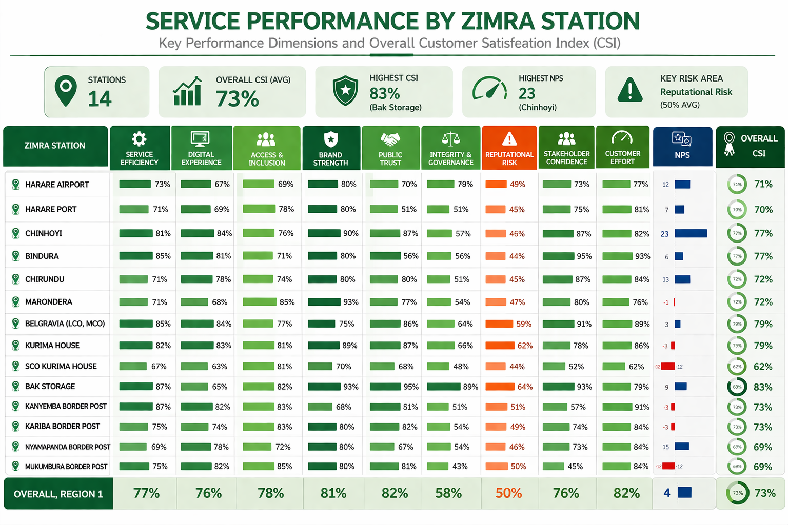

Slide 57
SERVICE DELIVERY BY ATTRIBUTE- REGION 1
1. Service Efficiency and Competence (77%)
This reflects the ability of stations to deliver services consistently, within reasonable timeframes, and with adequate staff capability.
• Highest Satisfaction – indicate strong operational flow and service execution.
a) Bak Storage (87%)
b) Kanyemba Border Post (87%)
c) Bindura (85%) / Belgravia (85%)
• Moderate Satisfaction:
a) Kurima House (82%)
b) Chinhoyi (81%)
c) Kariba (75%) / Mukumbura (75%)
• Lowest Satisfaction – reflect pressure on processes and slower turnaround.
SCO Kurima House (67%)
b) Nyamapanda Border Post (69%)
c) Harare Port (71%) / Chirundu (71%) / Marondera (71%)
2. Digital Experience (76%)
This assesses how well systems support service delivery, including speed, availability, and usability.
• Highest Satisfaction – reflect well-supported digital environments.
a) Chinhoyi (84%)
b) Belgravia (84%)
c) Kurima House (83%) / Kanyemba (82%) / Mukumbura (82%)
• Moderate Satisfaction:
a) Bindura (81%)
b) Chirundu (78%) / Nyamapanda (78%)
c) Kariba (74%)
• Lowest Satisfaction – indicate system strain or inefficiencies.
a) SCO Kurima House (63%)
b) Bak Storage (65%)
c) Harare Airport (67%) / Marondera (68%)
Digital performance is uneven, with strong functionality in some centres, but clear strain in high-volume or specialised processing environments.

Slide 58
3. Access and Inclusion (78%)
This measures how easily clients can reach and utilise services across locations and service points.
• Highest Satisfaction – show strong accessibility and service reach.
a) Marondera (85%)
b) Mukumbura Border Post (85%)
c) Kanyemba (83%) / Kariba (83%)
• Moderate Satisfaction:
a) Kurima House (81%) / SCO Kurima House (81%)
b) Belgravia (77%) / Chinhoyi (76%)
c) Chirundu (74%)
• Lowest Satisfaction – indicate barriers to service access.
a) Harare Airport (69%)
b) Bindura (71%)
c) Nyamapanda (72%)
Access is broadly effective across Region 1, though some stations—particularly high-traffic or specialised points face accessibility and congestion-related constraints.
4. Brand Strength / Reputation (81%)
This reflects how clients perceive ZIMRA in terms of credibility, professionalism, and overall service image.
• Highest Satisfaction – demonstrate strong institutional perception.
a) Marondera (93%)
b) Bak Storage (93%)
c) Chinhoyi (90%) / Kurima House (89%)
• Moderate Satisfaction:
a) Harare Airport (80%) / Harare Port (80%) / Bindura (80%)
b) Chirundu (80%) / Kariba (80%) / Nyamapanda (80%)
• Lowest Satisfaction – indicate perception gaps linked to service experience.
a) Kanyemba Border Post (68%)
b) SCO Kurima House (70%)
c) Belgravia (75%)
Brand perception remains strong overall, but is sensitive to local service experience, particularly at border and high-pressure operational points.

Slide 59
5. Public Trust (82%)
• Highest Satisfaction – reflect strong confidence in service delivery and processes.
a) Bak Storage (95%)
b) Bindura (90%)
c) Kanyemba (89%) / Kurima House (87%)
• Moderate Satisfaction:
a) Belgravia (86%)
b) Chinhoyi (87%) / Kariba (82%)
c) Mukumbura (81%)
• Lowest Satisfaction – indicate areas where trust is less reinforced.
a) Nyamapanda Border Post (67%)
b) SCO Kurima House (68%)
c) Harare Airport (77%) / Marondera (77%)
Trust levels are generally strong, but remain vulnerable in high-pressure or inconsistent service environments.
6. Integrity and Governance Climate (58%)
This assesses perceptions of fairness, transparency, and adherence to procedures.
• Highest Satisfaction – reflect stronger governance practices.
a) Bak Storage (89%)
b) Kurima House (66%)
c) Belgravia (64%)
• Moderate Satisfaction:
a) Chinhoyi (57%) / Bindura (56%)
b) Kariba (54%) / Marondera (54%)
• Lowest Satisfaction – highlight governance concerns.
a) Mukumbura Border Post (43%)
b) SCO Kurima House (48%)
c) Harare Port / Chirundu / Kanyemba (51%)
Governance emerges as a clear area of weakness in Region 1, with perceptions of inconsistency and limited transparency affecting confidence.

Slide 60
7. Reputational Risk Indicator (50%)
• Highest Satisfaction – lower exposure to reputational risk.
a) Bak Storage (64%)
b) Kurima House (62%)
c) Belgravia (59%)
• Moderate Satisfaction:
a) Mukumbura (50%)
b) Kanyemba (51%)
• Lowest Satisfaction – indicate higher reputational vulnerability.
a) Bindura (44%)
b) SCO Kurima House (44%)
c) Harare Port / Chirundu (45%)
Reputational risk is relatively elevated across the region, suggesting that negative service experiences are still influencing client perception.
8. Stakeholder Confidence (76%)
• Highest Satisfaction – indicate strong belief in service reliability.
a) Bindura (95%)
b) Bak Storage (93%)
c) Belgravia (91%)
• Moderate Satisfaction:
a) Chinhoyi (87%) / Chirundu (87%)
b) Kurima House (78%) / Harare Port (75%)
• Lowest Satisfaction – indicate confidence gaps.
a) Mukumbura (45%)
b) SCO Kurima House (52%)
c) Kanyemba (57%)
Confidence is strong in well-performing stations, but declines sharply where service consistency and governance are weaker.

Slide 61
9. Customer Effort Score (82%)
This measures how easy it is for clients to complete transactions and access services.
• Highest Satisfaction (Low Effort) – reflect smoother client journeys.
a) Bindura (93%)
b) Kanyemba (91%)
c) Belgravia (89%) / Kurima House (86%)
• Moderate Satisfaction:
a) Chinhoyi (82%)
b) Harare Port (81%)
c) Chirundu / Kariba / Nyamapanda (84%)
• Lowest Satisfaction (High Effort) – indicate complexity and inefficiencies.
a) SCO Kurima House (62%)
b) Harare Airport (77%)
c) Marondera (76%)
While effort is generally low (positive), certain stations still present complex processes and operational friction.
10. Net Promoter Score (NPS: 4)
• Highest Advocacy – reflect strong positive client experience.
a) Chinhoyi (23)
b) Nyamapanda (15)
c) Chirundu (13)
• Moderate Advocacy:
a) Harare Airport (12)
b) Bak Storage (9)
c) Harare Port (7)
• Lowest Advocacy – reflect dissatisfaction or weak experience.
a) SCO Kurima House (-12)
b) Mukumbura (-12)
c) Kanyemba / Kariba / Kurima (-3)
Client advocacy remains relatively low, indicating that while services are functional, they do not consistently create strong positive experiences.

Slide 62
Station | Pain Points (Simple) | Recommendations (Simple)
Bak Storage | Slow processe, long queues, too many documents, poor customer service, and slow systems | Simplify processes reduce paperwork improve systems increase staff improve customer service
Belgravia | Slow systems, poor communication, too many documents, unclear tax rules, and poor staff attitude | Upgrade systems improve communication simplify documentation rain staff clarify tax policies
Bindura | Poor communication, system delays, too many requirements, slow service, and corruption concerns | Improve communication upgrade systems simplify requirements increase staff enforce transparency
Chinhoyi | Poor contact centre response, inconsistent timelines, complex processes, and system issues | Improve contact centre standardise timelines simplify processes upgrade systems

Slide 63
Chirundu | System delays, too many documents, poor communication, corruption concerns, and repeated delays | Improve systems simplify processes strengthen communication enforce anti-corruption measures
Harare Airport | Delays, complex processes, high penalties/duties, poor communication, and system instability | Simplify processes improve systems review penalties improve communication support digital services
Harare Port | Poor communication, slow systems, too many documents, delays during peak periods, and poor staff attitude | Improve communication upgrade systems simplify documentation increase staff during peak periods
Kanyemba | Long queues, system issues, limited engagement, and fairness concerns | Improve systems increase staff strengthen stakeholder engagement ensure fair service delivery
Kariba | Complex tax processes, delays, poor communication, corruption concerns, and too many documents | Simplify tax processes improve communication strengthen controls upgrade systems reduce paperwork

Slide 64
Kurima House | Slow systems, poor communication, too many documents, corruption concerns, and slow service | Upgrade systems improve communication simplify requirements enforce anti-corruption improve service delivery
Marondera | Poor communication, slow systems, too many documents, poor customer service, and lack of transparency | Improve communication upgrade systems simplify documentation strengthen customer service
Mukumbura | Slow responses, poor communication, staff shortages during peak periods, and difficult processes | Improve response times strengthen communication increase staffing simplify processes
Nyamapanda | Delays during peak periods, communication gaps, and enforcement concerns | Increase staffing improve communication ensure fair and supportive service
SCO Kurima House | Slow systems, too many documents, poor communication, corruption concerns, and high duty fees | Upgrade systems simplify documentation improve communication; enforce transparency review duty fees

Slide 65
SERVICE CHALLENGES ANALYSIS- REGION 1
Service delivery challenges in Region 1 are characterised by severe delays at key border posts, concentrated system inefficiencies in urban centres, and uneven communication and information clarity across stations indicating the need for targeted, station-specific interventions rather than uniform solutions.
REGION 1 | DELAYS | COMMUNICATION | SYSTEM ISSUES | UNCLEAR INFORMATION | DOCUMENTATION REQUIREMENTS
Harare Airport | 30% | 11% | 30% | 9% | 20%
Harare Port | 24% | 19% | 26% | 13% | 19%
Chinhoyi | 25% | 13% | 21% | 21% | 21%
Bindura | 24% | 35% | 18% | 0% | 24%
Chirundu | 39% | 6% | 15% | 15% | 24%
Marondera | 35% | 9% | 40% | 12% | 5%
Belgravia Office (LCO, MCO) | 15% | 29% | 24% | 15% | 18%
Kurima House | 19% | 21% | 23% | 18% | 18%
SCO Kurima House | 27% | 14% | 31% | 18% | 11%
Bak Storage | 30% | 22% | 17% | 13% | 17%
Kanyemba Border Post | 25% | 13% | 38% | 13% | 13%
Kariba Border Post | 24% | 22% | 12% | 16% | 24%
Nyamapanda Border Post | 62% | 15% | 0% | 23% | 0%
Mukumbura Border Post | 33% | 17% | 0% | 33% | 17%
OVERALL | 29% | 18% | 21% | 16% | 17%

Slide 66
Major Challenge: Delays (29% Overall)
Delays are the most dominant service challenge across Region 1, with significantly higher concentrations at selected border posts and high-traffic stations.
Border Posts (e.g., Nyamapanda, Chirundu, Mukumbura, Kanyemba):
  Severe congestion and long clearance times
  Heavy traffic volumes, especially at major entry points
  Staff capacity constraints during peak periods
Urban / Administrative Stations (e.g., Harare Airport, Harare Port, SCO Kurima House):
  Slower turnaround times for processing requests
  Delays in handling complex or high-volume transactions
Delays in Region 1 are more uneven but more severe in specific locations, particularly at major border posts, indicating localized operational pressure rather than uniform system-wide inefficiency.
System Issues (21% Overall)
System-related challenges are moderate overall but highly concentrated in specific stations, particularly those dependent on digital processing.
  System-intensive stations (e.g., Marondera – 40%, Kanyemba – 38%, SCO Kurima – 31%, Harare Airport – 30%):
System downtime affecting service delivery
Slow system performance during peak usage
High reliance on digital platforms
  Border Posts (e.g., Nyamapanda, Mukumbura – 0%):
Minimal system dependency
Processes rely more on manual systems
System challenges in Region 1 are not uniform but concentrated in digital-heavy environments, making system performance a critical bottleneck in administrative and urban stations.

Slide 67
Communication (18% Overall)
Communication challenges are moderately high but vary significantly across stations.
  High communication gaps (e.g., Bindura – 35%, Belgravia – 29%, Bak Storage – 22%, Kariba – 22%):
Limited feedback on queries
Weak follow-up mechanisms
Lack of proactive engagement
  Lower communication concerns (e.g., Chirundu – 6%, Marondera – 9%, Harare Airport – 11%):
More structured communication practices
Communication challenges in Region 1 are more pronounced in office-based environments, where expectations for responsiveness and feedback are higher.
Unclear Information (16% Overall)
Unclear information is a moderate and uneven challenge, with certain stations showing significantly higher levels of confusion.
  High-impact stations (e.g., Mukumbura – 33%, Nyamapanda – 23%, Chinhoyi – 21%):
Lack of clarity on procedures and requirements
Limited guidance for clients at remote locations
  Lower concern stations (e.g., Bindura – 0%):
Stronger communication and clearer processes
Information gaps are more pronounced in remote and border stations, where structured communication and guidance mechanisms are limited.

Slide 68
Documentation Requirements (17% Overall)
Documentation is a consistent challenge across Region 1, particularly in formal processing environments.
High documentation burden (e.g., Chirundu – 24%, Kariba – 24%, Bindura – 24%):
  Processes perceived as cumbersome and documentation-heavy
  Repetitive requirements increasing effort
Lower burden stations (e.g., Marondera – 5%, Nyamapanda – 0%):
  Simpler or less formalised processes
Documentation challenges are closely linked to formal service environments and border operations, contributing to both delays and increased customer effort.

Slide 69
REGION 2 ANALYSIS

Slide 70
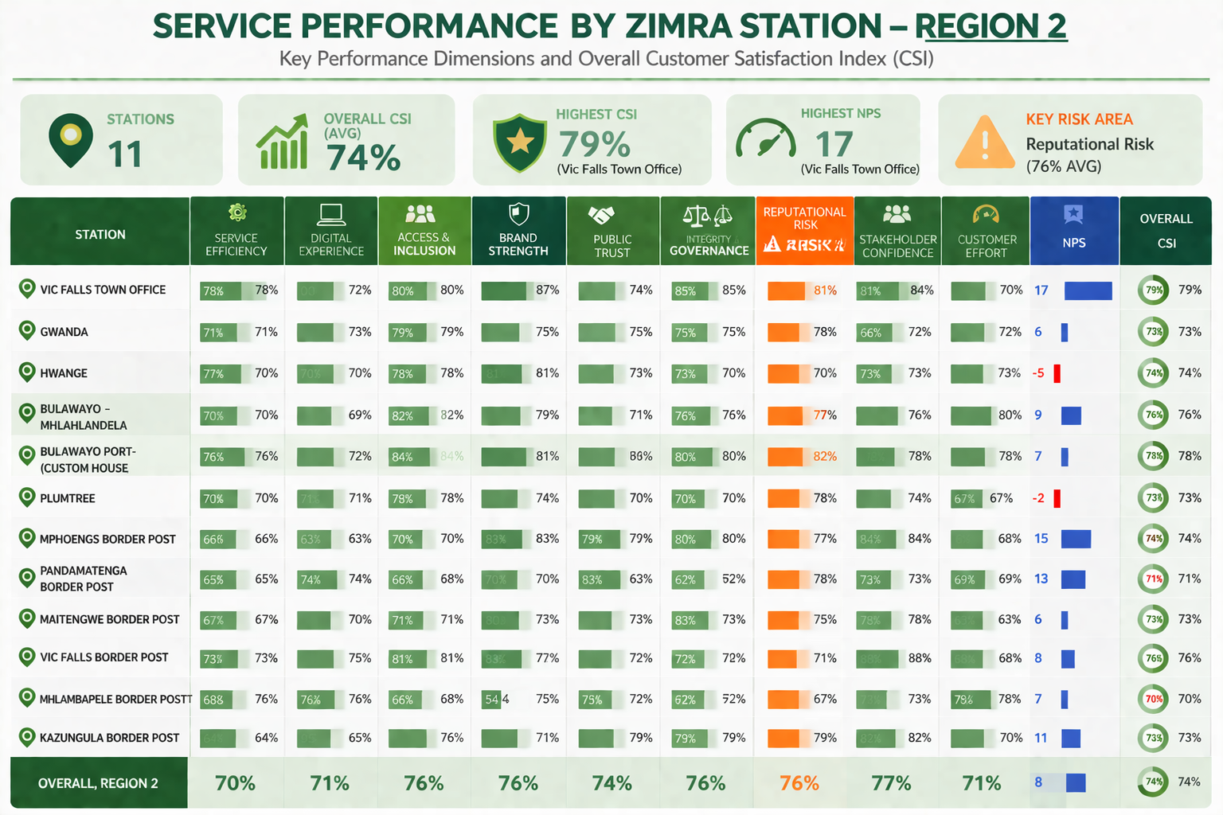

Slide 71
SERVICE DELIVERY BY ATTRIBUTE- REGION 2
1. Service Efficiency and Competence (70%)
This measures how effectively and professionally services are delivered, including turnaround times, staff capability, and process flow.
• Highest Satisfaction - demonstrate strong operational capacity and skilled personnel.
Victoria Falls Town Office (78%)
Hwange (77%)
Bulawayo Port – Custom House (76%)
• Moderate Satisfaction:
Victoria Falls Border Post (73%)
Gwanda (71%)
Bulawayo – Mhlahlandlela (70%)
Plumtree (70%)
• Lowest Satisfaction - indicate process inefficiencies, slower turnaround times, and capacity constraints.
Mphoengs Border Post (66%)
Pandamatenga Border Post (65%)
Kazungula Border Post (64%)
2. Digital Experience (71%)
This reflects the reliability, accessibility, and usability of digital systems and platforms.
• Highest Satisfaction - show relatively strong digital performance.
Mhlambapele Border Post (76%)
Victoria Falls Border Post (75%)
Pandamatenga Border Post (74%)
• Moderate Satisfaction:
Gwanda (73%)
Bulawayo Port – Custom House (72%)
Victoria Falls Town Office (72%)
Plumtree (71%)
• Lowest Satisfaction - highlight system limitations, slow performance, and possible downtime issues.
Mphoengs Border Post (63%)
Kazungula Border Post (65%)
Bulawayo – Mhlahlandlela (69%)

Slide 72
3. Access and Inclusion (76%)
• Highest Satisfaction - indicate well-structured and accessible service points.
Bulawayo Port – Custom House (84%)
Bulawayo – Mhlahlandlela (82%)
Victoria Falls Border Post (81%)
• Moderate Satisfaction:
Victoria Falls Town Office (80%)
Gwanda (79%)
Hwange (78%)
Plumtree (78%)
• Lowest Satisfaction - suggest geographic, operational, or service access challenges.
Pandamatenga Border Post (68%)
Mhlambapele Border Post (68%)
Mphoengs Border Post (70%)
4. Brand Strength / Reputation (76%)
This reflects how clients perceive ZIMRA in terms of professionalism, reliability, and overall image.
• Highest Satisfaction - indicates positive client experience and trust reinforcement.
Victoria Falls Town Office (87%)
Mphoengs Border Post (83%)
Victoria Falls Border Post (83%)
• Moderate Satisfaction:
Bulawayo Port – Custom House (81%)
Hwange (81%)
Bulawayo – Mhlahlandlela (79%)
• Lowest Satisfaction - highlights serious perception challenges driven by service experience issues.
Mhlambapele Border Post (54%)
Pandamatenga Border Post (70%)

Slide 73
5. Public Trust (74%)
• Highest Satisfaction - suggest confidence in institutional processes.
Pandamatenga Border Post (83%)
Mphoengs Border Post (79%)
Victoria Falls Town Office (74%) / Bulawayo Port (74%)
• Moderate Satisfaction:
Plumtree (74%)
Mhlambapele Border Post (75%)
Kazungula Border Post (71%)
• Lowest Satisfaction - indicate inconsistent service experiences affecting trust.
Hwange (69%)
Bulawayo – Mhlahlandlela (71%)
Gwanda (72%)
6. Integrity and Governance Climate (76%)
This assesses perceptions of transparency, fairness, and adherence to procedures.
• Highest Satisfaction - reflects confidence in governance and ethical conduct.
Victoria Falls Town Office (85%)
Maitengwe Border Post (83%)
Bulawayo Port – Custom House (80%) / Mphoengs (80%)
• Moderate Satisfaction:
Bulawayo – Mhlahlandlela (76%)
Gwanda (75%)
Kazungula Border Post (79%)
• Lowest Satisfaction - indicate concerns around consistency, fairness, or procedural clarity.
Pandamatenga Border Post (62%)
Plumtree (70%)
Hwange (73%)

Slide 74
STATION | PAIN POINTS | RECOMMENDATIONS
Victoria Falls Town Office | - Clients still rely heavily on physical visits despite digital options - Delayed responses to emails and queries - Unclear guidance on tax procedures for some clients | - Promote digital platforms and self-service channels - Introduce response time standards (SLAs) - Provide clear guidance (FAQs, client education sessions)
Gwanda | - Limited feedback on submitted queries - Perceived slow handling of requests - Inconsistent communication from staff | - Strengthen communication protocols and updates - Implement query tracking systems - Train staff on consistent client engagement
Hwange | - Negative client experience (low NPS) - Clients feel issues are not resolved effectively - Slow response to complaints | - Improve complaint resolution systems - Train staff on customer service and empathy - Introduce service quality monitoring
Bulawayo – Mhlahlandlela | - System-related delays affecting service speed - Clients go through multiple steps for simple processes - Moderate inefficiencies in workflows | - Improve system performance and speed - Streamline internal processes - Reduce unnecessary process steps

Slide 75
Bulawayo Port – Custom House | - Excessive documentation requirements - Duplication of checks and controls - Processes perceived as lengthy and complex | - Simplify documentation requirements - Introduce risk-based clearance processes - Reduce duplication and improve workflow efficiency
Plumtree Border Post | - Delays in clearance processes - Unclear procedures and requirements - High effort due to repetitive checks | - Provide clear process guidelines at service points - Improve queue and flow management - Reduce duplication in processes
Mphoengs Border Post | - Slow system performance and downtime - Low processing efficiency - Delays linked to system dependence | - Upgrade system infrastructure and reliability - Introduce backup systems - Improve processing turnaround times
Pandamatenga Border Post | - Staff shortages affecting service delivery - Delays during holidays and peak periods - Concerns about fairness and transparency - Limited accessibility | - Increase staffing during peak periods - Strengthen transparency in procedures - Improve service accessibility and support systems

Slide 76
Maitengwe Border Post | - Too many documentations requirements - Complex and duplicated processes - High customer effort | - Simplify documentation and procedures - Streamline process flows - Provide clear service guidance
Victoria Falls Border Post | - Delays during peak traffic periods - Limited communication on service progress - Clients lack real-time updates | - Improve queue management systems - Introduce real-time communication (SMS/email alerts) - Deploy additional staff during peak periods
Mhlambapele Border Post | - Very low brand perception (poor client experience) - Reports of rude/unprofessional staff behaviour - System inefficiencies and delays | - Strengthen staff training (professionalism & customer care) - Improve system performance - Introduce service quality monitoring mechanisms
Kazungula Border Post | - Slow processing and clearance delays - System inefficiencies - Moderate customer effort due to process complexity | - Improve system speed and reliability - Enhance operational efficiency - Introduce faster and streamlined processing

Slide 77
SERVICE CHALLENGES ANALYSIS- REGION 2
Station | Delays | System Issues | Unclear Information | Communication | Documentation | None
VIC FALLS TOWN OFFICE | 26% | 23% | 10% | 19% | 15% | 7%
GWANDA | 26% | 23% | 10% | 19% | 15% | 7%
HWANGE | 26% | 23% | 10% | 19% | 15% | 7%
BULAWAYO – MHLAHLANDELA | 23% | 26% | 7% | 16% | 11% | 16%
BULAWAYO PORT – CUSTOM HOUSE | 26% | 23% | 10% | 19% | 15% | 7%
PLUMTREE | 26% | 23% | 10% | 19% | 15% | 7%
MPHOENGS BORDER POST | 26% | 23% | 10% | 19% | 15% | 7%
PANDAMATENGA BORDER POST | 26% | 23% | 10% | 19% | 15% | 7%
MAITENGWE BORDER POST | 26% | 23% | 10% | 19% | 15% | 7%
VIC FALLS BORDER POST | 26% | 23% | 10% | 19% | 15% | 7%
MHLAMBAPELE BORDER POST | 26% | 23% | 10% | 19% | 15% | 7%
KAZUNGULA BORDER POST | 26% | 23% | 10% | 19% | 15% | 7%
OVERALL REGION 2 | 26% | 23% | 10% | 18% | 15% | 8%

Slide 78
Major Challenge: Delays (26% Across Most Stations)
Delays are the most dominant service challenge across Region 2, consistently reported across nearly all stations, particularly at border posts.
Border Posts (e.g., Plumtree, Pandamatenga, Mphoengs, Kazungula):
  Congestion during peak periods
  Clearance bottlenecks and verification processes
  Staff capacity constraints
Urban Stations (e.g., Gwanda, Hwange, Vic Falls Town):
  Slower turnaround times for requests
  Delays in resolving client queries
Delays are a structural issue across Region 2, driven by operational pressure, staffing constraints, and process inefficiencies particularly in high-traffic border environments.
System Issues (23% Across Stations)
System-related challenges are consistently reported across all stations, indicating a widespread dependency on digital platforms.
System-dependent stations (e.g., Bulawayo Mhlahlandlela – highest at 26%):
  System downtime affecting processing
  Slow system response during peak usage
Border Posts:
  Delays compounded when systems are unavailable
  Limited fallback mechanisms
Service delivery across Region 2 is highly dependent on system performance, making system reliability a critical enabler of efficiency.

Slide 79
Unclear Information (10% | Lower but Consistent)
Although lower in proportion, unclear information remains a recurring issue across all stations.
Clients report:
  Lack of clarity on procedures and requirements
  Uncertainty in tax processes and documentation
Bulawayo Mhlahlandlela (7%) performs slightly better, suggesting stronger information handling
👉 Insight - Information gaps are not dominant but persistent, contributing to repeated queries and increased customer effort.
Communication (18% Overall)
Communication challenges are moderately high and consistent across stations.
Clients experience:
  Limited updates on service progress
  Weak feedback mechanisms
  Lack of proactive engagement
Slightly lower in Bulawayo Mhlahlandlela (16%), indicating relatively better communication practices
Documentation Requirements (15% Across Stations)
Documentation is a consistent pain point across all stations.
Clients perceive:
  Requirements as excessive
  Processes as repetitive and cumbersome
Slightly lower at Bulawayo Mhlahlandlela (11%), suggesting more streamlined processes
👉 Insight - Documentation contributes significantly to high customer effort and process delays, especially at border posts.
No Challenges (7% | 16% at Bulawayo Mhlahlandlela)
Most stations report very low “no challenge” responses (7%), indicating:
  The majority of clients experience at least one issue
Bulawayo Mhlahlandlela (16%) stands out, suggesting:
  A relatively smoother and more efficient service experience
👉 Insight - Fully seamless service experiences are limited across Region 2, with only a few stations achieving noticeably better client journeys.

Slide 80
REGION 3 ANALYSIS

Slide 81
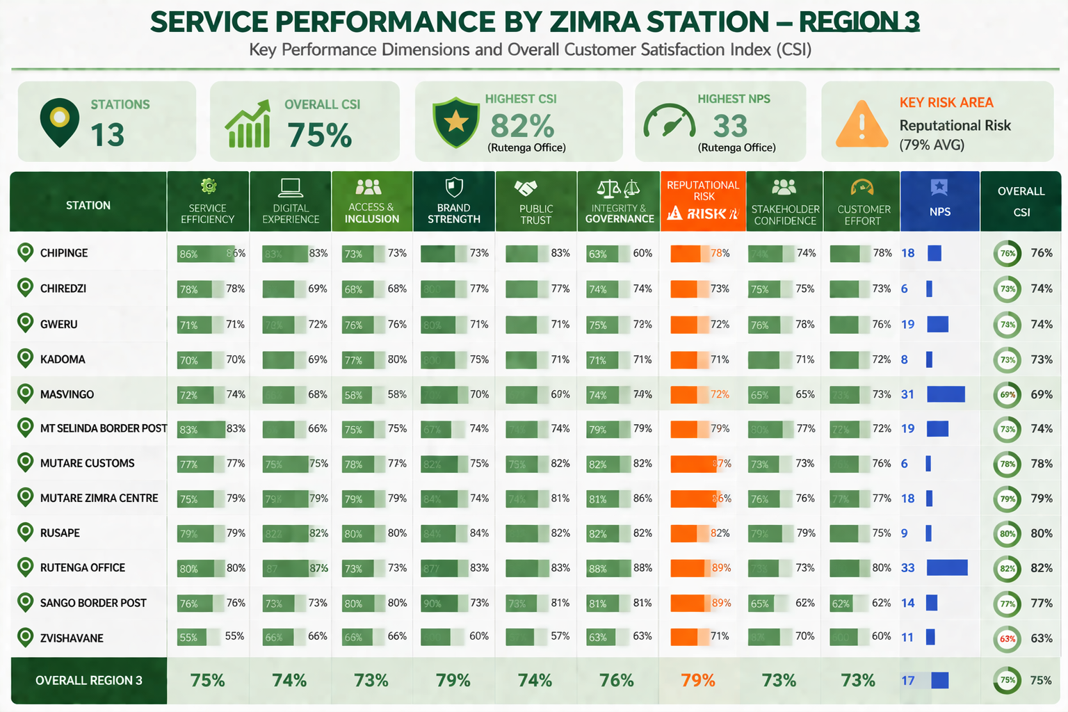

Slide 82
SERVICE DELIVERY BY ATTRIBUTE- REGION 3
1. Service Efficiency and Competence (75%)
This reflects how effectively stations are able to process transactions, manage workloads, and deliver timely services.
• Highest Satisfaction – indicate strong operational execution and responsiveness.
a) Chipinge (86%)
b) Mt Selinda Border Post (83%)
c) Rutenga Office (80%) / Rusape (79%)
• Moderate Satisfaction:
a) Mutare Customs (77%) / Sango Border Post (76%)
b) Masvingo (72%) / Kwekwe (74%)
c) Kadoma (70%) / Gweru (71%)
• Lowest Satisfaction – reflect operational strain and slower processing.
a) Zvishavane (55%)
b) Kadoma (70%)
c) Gweru (71%)
2. Digital Experience (74%)
This evaluates how well digital systems support service delivery in terms of speed, accessibility, and reliability.
• Highest Satisfaction – reflect well-functioning digital platforms.
a) Rutenga Office (87%)
b) Rusape (82%)
c) Chipinge (83%)
• Moderate Satisfaction:
a) Mutare ZIMRA Centre (79%)
b) Mutare Customs (75%)
c) Sango Border Post (73%)
• Lowest Satisfaction – indicate system limitations or slower performance.
a) Mt Selinda Border Post (66%)
b) Zvishavane (66%)
c) Masvingo (68%) / Kwekwe (68%)

Slide 83
3. Access and Inclusion (73%)
This measures how easily clients are able to access services across locations and service points.
• Highest Satisfaction – indicate strong service reach and accessibility.
a) Rusape (80%)
b) Sango Border Post (80%)
c) Mutare ZIMRA Centre (79%)
• Moderate Satisfaction:
a) Mutare Customs (78%)
b) Kadoma (77%) / Gweru (76%)
c) Mt Selinda Border Post (75%)
• Lowest Satisfaction – suggest access limitations or structural barriers.
a) Kwekwe (58%)
b) Zvishavane (66%)
c) Masvingo (67%)
4. Brand Strength / Reputation (79%)
This reflects client perception of professionalism, reliability, and institutional image.
• Highest Satisfaction – indicate strong institutional perception.
a) Sango Border Post (90%)
b) Masvingo (87%) / Rutenga Office (87%)
c) Rusape (84%) / Mutare ZIMRA Centre (84%)
• Moderate Satisfaction:
a) Chiredzi (80%) / Gweru (80%) / Kadoma (80%)
b) Mutare Customs (82%)
• Lowest Satisfaction – indicate perception challenges linked to service experience.
a) Zvishavane (60%)
b) Mt Selinda Border Post (67%)
c) Kwekwe (70%)

Slide 84
challenges are more pronounced.
5. Public Trust (74%)
• Highest Satisfaction – reflect confidence in service delivery and fairness.
a) Rutenga Office (83%)
b) Chipinge (83%)
c) Rusape (81%)
• Moderate Satisfaction:
a) Mutare Customs (75%) / Mutare ZIMRA Centre (74%)
b) Mt Selinda Border Post (74%)
c) Kadoma (75%)
• Lowest Satisfaction – indicate weaker confidence in service processes.
a) Zvishavane (57%)
b) Kwekwe (67%)
c) Nyamapanda-equivalent pattern seen in lower-performing stations
6. Integrity and Governance Climate (76%)
This assesses perceptions of fairness, transparency, and adherence to procedures.
• Highest Satisfaction – reflect strong governance practices.
a) Rutenga Office (88%)
b) Rusape (82%) / Mutare Customs (82%)
c) Mutare ZIMRA Centre (81%) / Sango Border Post (81%)
• Moderate Satisfaction:
a) Masvingo (76%) / Gweru (75%) / Chiredzi (74%)
b) Kadoma (71%)
• Lowest Satisfaction – indicate governance concerns.
a) Chipinge (60%)
b) Zvishavane (63%)
c) Kwekwe (74%) (relative to others)

Slide 85
fairness and consistency.
7. Reputational Risk Indicator (79%)
• Highest Satisfaction – indicate lower reputational risk exposure.
a) Rutenga Office (89%)
b) Sango Border Post (89%)
c) Mutare Customs (87%) / Mutare ZIMRA Centre (86%)
• Moderate Satisfaction:
a) Rusape (82%)
b) Masvingo (77%)
c) Chiredzi (73%)
• Lowest Satisfaction – indicate higher reputational vulnerability.
a) Zvishavane (71%)
b) Gweru (72%) / Kwekwe (72%)
8. Stakeholder Confidence (73%)
• Highest Satisfaction – reflect strong confidence in service reliability.
a) Masvingo (80%)
b) Rusape (79%)
c) Mt Selinda Border Post (77%)
• Moderate Satisfaction:
a) Gweru (76%) / Chiredzi (75%) / Chipinge (74%)
b) Mutare ZIMRA Centre (76%)
• Lowest Satisfaction – indicate confidence gaps.
a) Sango Border Post (65%)
b) Kwekwe (65%)
c) Zvishavane (70%)

Slide 86
9. Customer Effort Score (73%)
This measures how easy it is for clients to complete transactions and access services.
Highest Satisfaction (Low Effort) – indicate smoother service processes.
a) Rutenga Office (80%)
b) Chipinge (78%)
c) Mutare ZIMRA Centre (77%)
Moderate Satisfaction:
a) Mutare Customs (76%) / Gweru (76%)
b) Rusape (75%)
c) Masvingo (72%)
Lowest Satisfaction (High Effort) – indicate process complexity.
a) Zvishavane (60%)
b) Sango Border Post (62%)
c) Kwekwe (73%) (relative strain)
10. Net Promoter Score (NPS: 17)
Highest Advocacy – reflect strong positive client experience.
a) Rutenga Office (33)
b) Kwekwe (31)
c) Mt Selinda Border Post (29)
Moderate Advocacy:
a) Chipinge (18)
b) Gweru (19) / Masvingo (19)
c) Mutare ZIMRA Centre (18)
Lowest Advocacy – indicate weaker client experience.
a) Chiredzi (6)
b) Mutare Customs (6)
c) Zvishavane (11)

Slide 87
SERVICE CHALLENGES ANALYSIS - REGION 3
REGION 3 | DELAYS | COMMUNICATION | SYSTEM ISSUES | UNCLEAR INFORMATION | DOCUMENTATION REQUIREMENTS
CHIPINGE | 29% | 14% | 29% | 0% | 29%
CHIREDZI | 33% | 17% | 25% | 8% | 17%
GWERU | 17% | 26% | 35% | 9% | 13%
KADOMA | 26% | 18% | 18% | 18% | 21%
KWEKWE | 33% | 27% | 33% | 7% | 0%
MASVINGO | 32% | 26% | 15% | 9% | 18%
MT SELINDA BOARDER POSTS | 25% | 8% | 42% | 8% | 17%
MUTARE CUSTOMS | 36% | 10% | 27% | 12% | 15%
MUTARE ZIMRA CENTRE | 32% | 7% | 32% | 16% | 14%
RUSAPE | 33% | 28% | 28% | 0% | 11%
RUTENDA OFFICE | 67% | 0% | 33% | 33% | 33%
SANGO BOARDER POSTS | 17% | 0% | 33% | 17% | 50%
OVERALL | 32% | 15% | 29% | 11% | 20%

Slide 88
Major Challenge: Delays (32% Overall)
Delays are the most dominant challenge across Region 3, with particularly high concentration in specific stations rather than uniform distribution.
High-delay stations (e.g., Rutenga Office – 67%, Mutare Customs – 36%, Rusape – 33%, Kwekwe – 33%, Chiredzi – 33%)
Severe delays in processing transactions
Congestion and longer waiting times at service points
Limited processing capacity during peak periods
Moderate-delay stations (e.g., Chipinge – 29%, Kadoma – 26%, Mt Selinda – 25%)
Occasional delays linked to workflow inefficiencies
Slower turnaround times for certain services
Lower-delay stations (e.g., Gweru – 17%, Sango Border Post – 17%)
More manageable service flow
Relatively quicker processing times
System Issues (29% Overall)
System challenges are significant and widespread, with several stations showing very high dependence on system performance.
High system-constraint stations (e.g., Mt Selinda – 42%, Gweru – 35%, Kwekwe – 33%, Rutenga – 33%, Sango – 33%)
System downtime affecting service delivery
Slow processing speeds during peak usage
Heavy reliance on digital systems
Moderate system-impact stations (e.g., Mutare Customs – 27%, Chiredzi – 25%, Chipinge – 29%)
Intermittent system disruptions
Moderate delays linked to system performance
Lower system-impact stations (e.g., Masvingo – 15%, Kadoma – 18%)
Less reliance on digital systems
More stable processing environments

Slide 89
Unclear Information (11% Overall)
Unclear information is a moderate but uneven challenge, with certain stations experiencing significantly higher levels.
High-impact stations (e.g., Rutenga – 33%, Mutare ZIMRA Centre – 16%, Sango – 17%)
Clients unclear on procedures and requirements
Limited guidance during service interactions
Moderate-impact stations (e.g., Mutare Customs – 12%, Gweru – 9%, Masvingo – 9%)
Occasional confusion on processes
Minimal concern stations (e.g., Chipinge – 0%, Rusape – 0%)
Clear communication and structured guidance
Communication (15% Overall)
Communication challenges are moderate but vary significantly across stations.
High communication gaps (e.g., Rusape – 28%, Kwekwe – 27%, Gweru – 26%, Masvingo – 26%)
a) Limited feedback on queries
b) Weak follow-up mechanisms
c) Lack of proactive engagement
Moderate communication levels (e.g., Kadoma – 18%, Chiredzi – 17%, Chipinge – 14%)
a) Some gaps in responsiveness
Minimal communication concerns (e.g., Rutenga – 0%, Sango – 0%)
a) More direct or simplified communication channels
Documentation Requirements (20% Overall)
Documentation is a significant and uneven challenge across Region 3, with some stations showing very high burden.
High documentation burden (e.g., Sango Border Post – 50%, Rutenga – 33%, Chipinge – 29%)
Excessive documentation requirements
Repetitive and complex processes
Moderate burden stations (e.g., Kadoma – 21%, Masvingo – 18%, Mutare Customs – 15%)

Slide 90
OVERALL PMRC IMPROVEMENTS
Overall Suggested Improvements for ZIMRA
1. System & Digital Platform
Upgrade and stabilise all digital platforms (TaRMS, online portals)
Ensure systems work 24/7 and perform consistently during peak hours
Improve ICT infrastructure and internet connectivity
Regular system maintenance and updates but please raise awareness first to the ZIMRA clients if there are any system maintenance issues
2. Service Efficiency & Process Improvements
Streamline workflows and reduce waiting times
Process rebates, refunds, and clearances faster
Introduce digital pre-clearance to reduce physical visits

Slide 91
6. Tax Compliance Support
Provide targeted SME training and support
Educate new taxpayers about processes and obligations
Simplify compliance procedures where possible
Review penalties and interest to be fair and reasonable
8. Documentation & Process Simplification
Reduce the number of required documents
Digitise forms and make them easily accessible
Organise forms systematically and ensure availability
Clarify issue reporting procedures
9. Infrastructure & Access
Ensure communication lines are functional at all times
Expand capacity for online and offline service access
10. Enforcement & Border Post Practices
Train border and enforcement staff for fair and respectful conduct
Reduce unnecessary inspections or confiscations
Improve efficiency during peak travel or holiday periods
3. Staffing & Capacity
Increase staffing at border posts and town offices
Deploy extra personnel during holidays and peak periods
Ensure adequate staffing in contact centres
4. Communication & Responsiveness
Improve responsiveness on phone lines, WhatsApp, and email
Standardise information shared with clients
Notify clients proactively about changes in policies or systems
Assign dedicated liaison officers for complex client queries
Conduct regular feedback surveys and workshops
5. Customer Service & Professionalism
Train staff on professionalism, ethics, and client engagement
Encourage respectful and supportive treatment of all taxpayers
Monitor staff conduct and enforce accountability
Do training to ZIMRA staff of Customer Handling or Customer Service Experience as well as Emotional Intelligence
Rotate staff to reduce opportunities for bias

